Slide 2
Lecture Outline
IT Security Management
IT Security Management Process
Polices and Mechanisms
Objective of Polices
Why Policy?
Bulls-Eye Model
Types of Information Security Policy
Trust and Assumptions
Assurance
Operational & Human Issues
Policy, Standards, and Practices
Risk
Risk Analysis
Risk Management vs. Cost of Security
CIA Risk and Control
Security as Risk Management
Risk Identification and assessment
Risk Control

Slide 3
Overview
Security requirements means asking
what assets do we need to protect?
how are those assets threatened?
what can we do to counter those threats?
IT security management answers these
determining security objectives and risk profile
perform security risk assessment of assets
select, implement, monitor controls

Slide 4
IT Security Management
IT Security Management: a process used to achieve and maintain appropriate levels of confidentiality, integrity, availability, accountability, authenticity and reliability. IT security management functions include:
organizational IT security objectives, strategies and policies
determining organizational IT security requirements
identifying and analyzing security threats to IT assets
identifying and analyzing risks
specifying appropriate safeguards
monitoring the implementation and operation of safeguards
developing and implement a security awareness program
detecting and reacting to incidents

Slide 5
Policies and Mechanisms
Policy says what is, and is not, allowed
This defines “security” for the site/system/etc.
Mechanisms enforce policies
Composition of policies
If policies conflict, discrepancies may create security vulnerabilities

Slide 6
Policies and Mechanisms (Cont’d)
Policy: may be expressed in
natural language, which is usually imprecise but easy to understand;
mathematics, which is usually precise but hard to understand;
policy languages, which look like some form of programming language and try to balance precision with ease of understanding
Mechanisms: may be
technical, in which controls in the computer enforce the policy; for example, the requirement that a user supply a password to authenticate herself before using the computer
procedural, in which controls outside the system enforce the policy; for example, firing someone for ringing in a disk containing a game program obtained from an untrusted source
The composition problem requires checking for inconsistencies among policies. If, for example, one policy allows students and faculty access to all data, and the other allows only faculty access to all the data, then they must be resolved

Slide 7
Objective of Policies
Reduced risk
Compliance with laws and regulations
Assurance of operational continuity, information integrity, and confidentiality

Slide 8

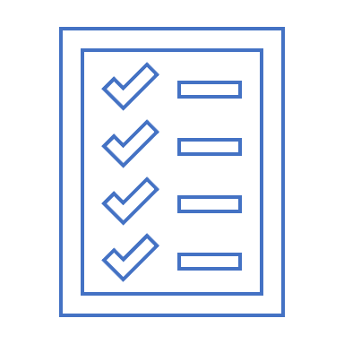
Why Policies?
Policies are the least expensive means of control and often the most difficult to implement
Basic rules for shaping a policy
Policy should never conflict with law
Policy must be able to stand up in court if challenged
Policy must be properly supported and administered
Notes:
Policies are important reference documents
For internal audits
For the resolution of legal disputes about management's due diligence
Policy documents can act as a clear statement of management's intent

Slide 9
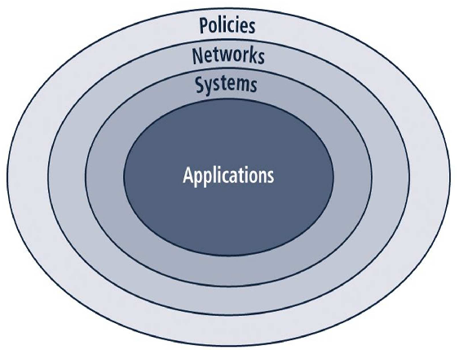
Bulls-Eye Model
Notes:
Bulls-eye model
Networks: threats first meet the organization’s network
Systems: computers and manufacturing systems
Applications: all applications systems

Slide 10
Types of Information Security Policy
Enterprise information security program policy
Issue-specific information security policies
Systems-specific policies
Notes:
Enterprise information security program policy
An enterprise information security policy is a set of rules that people with access to the organization's data, assets, networks, and other IT resources must follow to minimize cyber risk exposure.
Issue-specific information security policies
An issue-specific security policy addresses a specific area of technology within an organization, such as email, or use of the internet.
Systems-specific policies
A system-specific security policy is concerned with specific systems or types of system. It describes hardware and software approved for that system and how that system is to be protected.

Slide 11
Types of Information Security Policy (Cont’d)
Enterprise information security program policy
Describes the whole organization’s security objectives and its commitment to information security. It can be thought of as the primary document from which other security policies are derived. Also, it often informs the organization’s compliance goals.
Notes:
Enterprise information security program policy
An enterprise information security policy is a set of rules that people with access to the organization's data, assets, networks, and other IT resources must follow to minimize cyber risk exposure.
Issue-specific information security policies
An issue-specific security policy addresses a specific area of technology within an organization, such as email, or use of the internet.
Systems-specific policies
A system-specific security policy is concerned with specific systems or types of system. It describes hardware and software approved for that system and how that system is to be protected.

Slide 12
Types of Information Security Policy (Cont’d)
Issue-specific information security policies
Provide guidelines for particular threats or categories of threats.
For example, an organization may create a security policy that focuses on phishing attacks or general email security.
Notes:
Enterprise information security program policy
An enterprise information security policy is a set of rules that people with access to the organization's data, assets, networks, and other IT resources must follow to minimize cyber risk exposure.
Issue-specific information security policies
An issue-specific security policy addresses a specific area of technology within an organization, such as email, or use of the internet.
Systems-specific policies
A system-specific security policy is concerned with specific systems or types of system. It describes hardware and software approved for that system and how that system is to be protected.

Slide 13
Types of Information Security Policy (Cont’d)
Systems-specific policies
A system-specific security policy is concerned with specific systems or types of system. It describes hardware and software approved for that system and how that system is to be protected.
For example, policies for customer-facing applications, payroll systems, or data archive systems. They typically articulate security objectives and the operational security rules intended to support them.
Notes:
Enterprise information security program policy
An enterprise information security policy is a set of rules that people with access to the organization's data, assets, networks, and other IT resources must follow to minimize cyber risk exposure.
Issue-specific information security policies
An issue-specific security policy addresses a specific area of technology within an organization, such as email, or use of the internet.
Systems-specific policies
A system-specific security policy is concerned with specific systems or types of system. It describes hardware and software approved for that system and how that system is to be protected.

Slide 14
Policy, Standards, and Practices (Cont’d)
Policy: A plan or course of action that influences decisions
must be properly disseminated, read, understood, agreed-to, and uniformly enforced
require constant modification and maintenance
Standards
A more detailed statement of what must be done to comply with policy
Practices
Procedures and guidelines explain how employees will comply with policy
Notes:
14

Slide 15
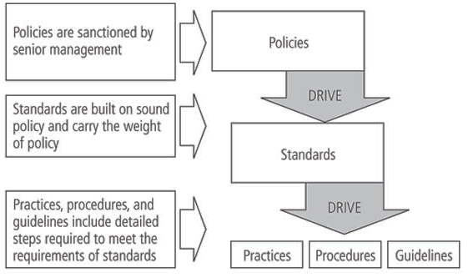
Policy, Standards, and Practices
Figure 4-2 Policies, standards and practices
Notes:
15

Slide 16

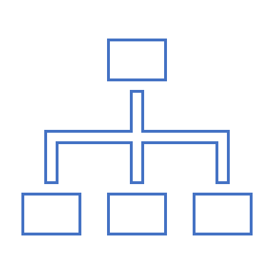




Seven Elements of an Effective Security Policy
1. Clear purpose and objectives
6. Tailored to the organization’s risk appetite
2. Scope and applicability
5. Clear definitions of important terms
3. Commitment from senior management
7. Up-to-date information
4. Realistic and enforceable policies
Figure 4-2 Policies, standards and practices
Notes:
1. Clear purpose and objectives
This is especially important for program policies. Remember that many employees have little knowledge of security threats, and may view any type of security control as a burden. A clear mission statement or purpose spelled out at the top level of a security policy should help the entire organization understand the importance of information security.
2. Scope and applicability
Every security policy, regardless of type, should include a scope or statement of applicability that clearly states to who the policy applies. This can be based around the geographic region, business unit, job role, or any other organizational concept so long as it's properly defined.
3. Commitment from senior management
Security policies are meant to communicate intent from senior management, ideally at the C-suite or board level. Without buy-in from this level of leadership, any security program is likely to fail. To succeed, your policies need to be communicated to employees, updated regularly, and enforced consistently. A lack of management support makes all of this difficult if not impossible.
4. Realistic and enforceable policies
While it might be tempting to base your security policy on a model of perfection, you must remember that your employees live in the real world. An overly burdensome policy isn’t likely to be widely adopted. Likewise, a policy with no mechanism for enforcement could easily be ignored by a significant number of employees.
5. Clear definitions of important terms
Remember that the audience for a security policy is often non-technical. Concise and jargon-free language is important, and any technical terms in the document should be clearly defined.
6. Tailored to the organization’s risk appetite
Risk can never be completely eliminated, but it’s up to each organization’s management to decide what level of risk is acceptable. A security policy must take this risk appetite into account, as it will affect the types of topics covered.
7. Up-to-date information
Security policy updates are crucial to maintaining effectiveness. While the program or master policy may not need to change frequently, it should still be reviewed on a regular basis. Issue-specific policies will need to be updated more often as technology, workforce trends, and other factors change. You may find new policies are also needed over time: BYOD and remote access policies are great examples of policies that have become ubiquitous only over the last decade or so.
16

Slide 17

Security Policy examples
Program or organizational policy
Firewall policy
Acceptable use policy
Email policy
Remote access policy
Data security policy
Figure 4-2 Policies, standards and practices
Notes:
Program or organizational policy: This high-level security blueprint is a must for all organizations, and spells out the goals and objectives of an information security program. The program policy also specifies roles and responsibilities, compliance monitoring and enforcement, and alignment with other organizational policies and principles.
Acceptable use policy: This is an issue-specific policy that defines the acceptable conditions under which an employee can access and use the company’s information resources.
Remote access policy: This issue-specific policy spells out how and when employees can remotely access company resources.
Data security policy: Data security can be addressed in the program policy, but it may also be helpful to have a dedicated policy describing data classification, ownership, and encryption principles for the organization.
Firewall policy: One of the most common system-specific policies, a firewall policy describes the types of traffic that an organization’s firewall(s) should allow or deny. Note that even at this level, the policy still describes only the “what”; a document describing how to configure a firewall to block certain types of traffic is a procedure, not a policy.
Email policy: An email policy is a formal document that provides employees with specific policy guidelines regarding office emails. An effective email policy will encourage positive, productive communications while protecting a company from legal liability, reputation damage, and security breaches.
17

Slide 18
Trust
Tools of computer security are resident on computers
Just as mutable as any other information on computers
Can we trust our computer?
Can we trust our software?
Can we trust our suppliers?
Can we trust our people?
Trust, but verify
Notes:
Mutable…capable to change

Slide 19
Trusting Our Computer
Hardware bugs
Hardware features
Peripheral bugs/features

Slide 20
Trusting Our Software
Operating system bugs and features
System software back-doors
Who wrote the software?
Who maintains the software?

Slide 21
Trusting Our Suppliers
Development process
Bugs
Testing
Configuration control
Distribution control
Hacker challenges

Slide 22
Trust, but Verify
Trust with a suspicious attitude
Ask questions
Do background checks
Test code
Get written assurances
Anticipate problems and attacks

Slide 23
Trust and Assumptions
Underlie all aspects of security
Policies
- Unambiguously partition system states
- Correctly capture security requirements
Mechanisms
- Assumed to enforce policy
- Support mechanisms work correctly
Example of lock picker
Notes:
All security policies and mechanisms rest on assumptions; we’ll examine some in later chapters, most notably Chapter 22, Malicious Logic. Here is a taste of the assumptions.
Policies: as these define security, they have to define security correctly for the particular site. For example, a web site has to be available, but if the security policy does not mention availability, the definition of security is inappropriate for the site. Also, a policy may not specify whether a particular state is “secure” or “non-secure.” This ambiguity causes problems.
Mechanisms: as these enforce policy, they must be appropriate. For example, cryptography does not assure availability, so using cryptography in the above situation won’t work. Further, security mechanisms rely on supporting infrastructure, such as compilers, libraries, the hardware, and networks to work correctly. Ken Thompson’s modified C preprocessor (see the example on p. 615) illustrates this point very well
EXAMPLE: Opening a door lock requires a key. The assumption is that the lock is secure against lock picking. This assumption is treated as an axiom and is made because most people would require a key to open a door lock. A good lock picker, however, can open a lock without a key. Hence, in an environment with a skilled, untrustworthy lock picker, the assumption is wrong and the consequence invalid
.
If the lock picker is trustworthy, the assumption is valid. The term “trustworthy” implies that the lock picker will not pick a lock unless the owner of the lock authorizes the lock picking. This is another example of the role of trust.

Slide 24
Assurance
Assurance is a measure of how well the system meets its requirements; more informally, how much you can trust the system to do what it is supposed to do. It does not say what the system is to do; rather, it only covers how well the system does it
System specification, design, and implementation can provide a basis for determining "how much" to trust a system
Specification
Requirements analysis
Statement of desired functionality
Design
How system will meet specification
Implementation
Programs/systems that carry out design
Notes:
Assurance is a measure of how well the system meets its requirements; more informally, how much you can trust the system to do what it is supposed to do. It does not say what the system is to do; rather, it only covers how well the system does it.
Specifications arise from requirements analysis, in which the goals of the system are determined. The specification says what the system must do to meet those requirements. It is a statement of functionality, not assurance, and can be very formal (mathematical) or informal (natural language). The specification can be high-level or low-level (for example, describing what the system as a whole is to do vs. what specific modules of code are to do).
The design architects the system to satisfy, or meet, the specifications. Typically, the design is layered by breaking the system into abstractions, and then refining the abstractions as you work your way down to the hardware. An analyst also must show the design matches the specification.
The implementation is the actual coding of the modules and software components. These must be correct (perform as specified), and their aggregation must satisfy the design.
Note the assumptions of correct compilers, hardware, etc.

Slide 25
Operational Issues
Security does not end when the system is completed. Its operation affects security
Cost-Benefit Analysis
Is it cheaper to prevent or recover?
Risk Analysis
Should we protect something?
How much should we protect this thing?
Laws and Customs
Are desired security measures illegal?
Will people do them?
Notes:
Security does not end when the system is completed. Its operation affects security. A “secure” system can be breached by improper operation (for example, when accounts with no passwords are created). The question is how to assess the effect of operational issues on security.
Cost-Benefit Analysis: this weighs the cost of protecting data and resources with the costs associated with losing the data. Among the considerations are the overlap of mechanisms’ effects (one mechanism may protect multiple services, so its cost is amortized), the non-technical aspects of the mechanism (will it be impossible to enforce), and the ease of use (if a mechanism is too cumbersome, it may cost more to retrofit a decent user interface than the benefits would warrant).
Risk Analysis: what happens if the data and resources are compromised? This tells you what you need to protect and to what level. Cost-benefit analyses help determine the risk here, but there may be other metrics involved (such as customs).
Laws and Customs: these constrain what you can do. Encryption used to be the biggie here, as the text indicates. How much that has changed is anybody’s guess. Customs involve non-legislated things, like the use of urine specimens to determine identity. That is legal, at least in the US in some cases; but it would never be widely accepted as an alternative to a password.

Slide 26
Human Issues
Organizational Problems
Power and responsibility
Financial benefits (security does not bring in revenue, it merely prevents the loss of revenue )
People problems
Heart of any security system is people
Outsiders and insiders
Social Engineering
Notes:
Organizations: the key here is that those responsible for security have the power to enforce security. Otherwise there is confusion, and the architects need not worry if the system is secure because they won’t be blamed if someone gets in. This arises when system administrators, for example, are responsible for security, but only security officers can make the rules. Preventing this problem (power without responsibility, or vice versa) is tricky and requires capable management. What’s worse is that security is not a direct financial incentive for most companies because it doesn’t bring in revenue. It merely prevents the loss of revenue obtained from other sources.
People problems are by far the main source of security problems. Outsiders are attackers from without the organization; insiders are people who have authorized access to the system and, possibly, are authorized to access data and resources, but use the data or resources in unauthorized ways. It is speculated that insiders account for 80-90% of all security problems, but the studies generally do not disclose their methodology in detail, so it is hard to know how accurate they are. (Worse, there are many slightly different definitions of the term “insider,” causing the studies to measure slightly different things!) Social engineering, or lying, is quite effective, especially if the people gulled are inexperienced in security (possibly because they are new, or because they are tired).

Slide 27
Tying Together
Threats
Policy
Specification
Design
Implementation
Operation
Notes:
The point to this slide is that each step feeds into the earlier steps. In theory, each of these should only affect the one before it, and the one after it. In practice, each affects all the ones that come before it.
Feedback from operation and maintenance is critical, and often overlooked. It allows one to validate the threats and the legitimacy of the policy.

Slide 28
Risk
The possibility that a particular vulnerability will be exploited
IT-related risks arise from:
Unauthorized (malicious or accidental) disclosure, modification, or destruction of information
Unintentional errors or omissions
IT disruptions due to natural or man-made disasters
Failure to exercise due care and diligence in implementation and operation of the IT system
Risk = Threat * Vulnerability (* Impact)

Slide 29
Risk Analysis
Identification, assessment and reduction of risks to an acceptable level
The process of identifying security risks and probability of occurrence, determining their impact, and identifying areas that require protection
Three parts:
– Risk assessment – determine the possible risks
– Risk management – evaluating alternatives for mitigating the risk
– Risk communication – presenting the material in an understandable way to decision makers and/or the public

Slide 30
Risk Management vs. Cost of Security
Risk mitigation
– The process of selecting appropriate controls to reduce risk to an acceptable level
The level of acceptable risk
– Determined by comparing the risk of security hole exposure to the cost of implementing and enforcing the security policy
Trade-offs between safety, cost, and availability

Slide 31
Risk Management
Managing a risk is one of the key responsibilities of every manager within the organization
In any well-developed security risk management program, two formal processes are at work:
Risk identification and assessment
Risk control

Slide 32
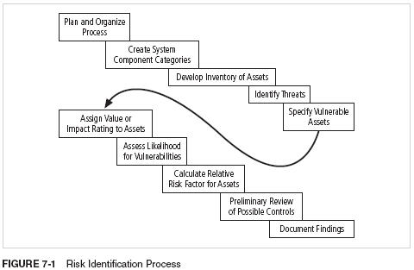
Risk Identification Process
Notes:
32

Slide 33
Organizational Assets Used in Systems
Notes:
33

Slide 34
Assessing Values for Information Assets
As each information asset is identified, categorized, and classified, assign a relative value
Relative values are comparative judgments made to ensure that the most valuable information assets are given the highest priority, for example:
Which information asset is the most critical to the success of the organization?
Which information asset generates the most revenue?
Which information asset generates the highest profitability?
Which information asset is the most expensive to replace?
Which information asset is the most expensive to protect?
Which information asset’s loss or compromise would be the most embarrassing or cause the greatest liability?
Notes:
34
Assessing Values for Information Assets
As each information asset is identified, categorized, and classified, a relative value must also be assigned to it.
Relative values are comparative judgments made to ensure that the most valuable information assets are given the highest priority when managing risk.
Which information asset is the most critical to the success of the organization?
Which information asset generates the most revenue?
Which information asset generates the highest profitability?
Which information asset is the most expensive to replace?
Which information asset is the most expensive to protect?
Which information asset’s loss or compromise would be the most embarrassing or cause the greatest liability?

Slide 35
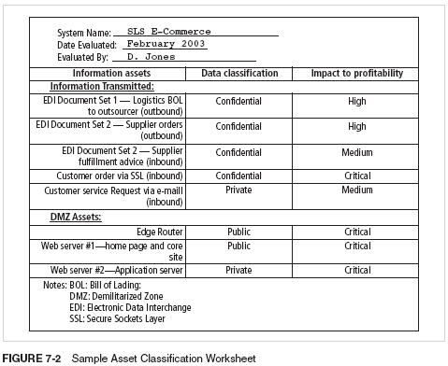
Sample Asset Classification Worksheet
Notes:
35

Slide 36
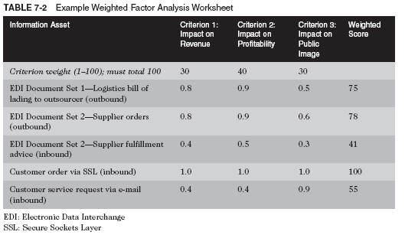
Weighted Factor Analysis Worksheet Example
Notes:
Calculation:
0.8 * 30 + 0.9 * 40 + 0.5 * 30 = 75
36

Slide 37
Threats to Information Security
Notes:
Trespas…enter someone's land or property without permission.
vandalism…action involving deliberate destruction of or damage to public or private property.
Infringment…the action of breaking the terms of a law, agreement, etc.; violation.
37

Slide 38
Vulnerability Assessment
Vulnerability---weakness of system
Once you have identified the information assets of the organization and documented some threat assessment criteria, you can begin to review every information asset for each threat
This review leads to the creation of a list of vulnerabilities that remain potential risks to the organization
Vulnerabilities are specific avenues that threat agents can exploit to attack an information asset
Notes:
38
Vulnerability Assessment
Once you have identified the information assets of the organization and documented some threat assessment criteria, you can begin to review every information asset for each threat.
This review leads to the creation of a list of vulnerabilities that remain potential risks to the organization.
Vulnerabilities are specific avenues that threat agents can exploit to attack an information asset.
At the end of the risk identification process, a list of assets and their vulnerabilities has been developed.
This list serves as the starting point for the next step in the risk management process—risk assessment.

Slide 39
Risk Identification Estimate Factors
Risk is
The likelihood of the occurrence of a vulnerability
Multiplied by
The value of the information asset
Minus
The percentage of risk mitigated by current controls
Plus
The uncertainty of current knowledge of the vulnerability
Notes:
39
Risk Identification Estimate Factors
Risk is
The likelihood of the occurrence of a vulnerability
Multiplied by
The value of the information asset
Minus
The percentage of risk mitigated by current controls
Plus
The uncertainty of current knowledge of the vulnerability

Slide 40
Access Controls
Access controls specifically address admission of a user into a trusted area of the organization
These areas can include information systems, physically restricted areas such as computer rooms, and even the organization in its entirety
Access controls usually consist of a combination of policies, programs, and technologies
Notes:
40
Access Controls
Access controls specifically address admission of a user into a trusted area of the organization.
These areas can include information systems, physically restricted areas such as computer rooms, and even the organization in its entirety.
Access controls usually consist of a combination of policies, programs, and technologies.

Slide 41
Risk Control Strategies
An organization must choose one of four basic strategies to control risks
Avoidance: applying safeguards that eliminate or reduce the remaining uncontrolled risks for the vulnerability
Transference: shifting the risk to other areas or to outside entities
Mitigation: reducing the impact should the vulnerability be exploited
Acceptance: understanding the consequences and accepting the risk without control or mitigation
Notes:
41
Risk Control Strategies
An organization must choose one of four basic strategies to control risks :
Avoidance: applying safeguards that eliminate or reduce the remaining uncontrolled risks for the vulnerability
Transference: shifting the risk to other areas or to outside entities
Mitigation: reducing the impact should the vulnerability be exploited
Acceptance: understanding the consequences and accept the risk without control or mitigation

Slide 42
CIA Risk and Control
CIA | RISK | CONTROL
Confidentiality | Loss of privacy, Unauthorized access to information, Identity theft. | Encryption, Authentication, Access Control
Integrity | Information is no longer reliable or accurate, Fraud. | Maker/Checker, Quality Assurance, Audit Logs
Availability | Business disruption, Loss of customer’s confidence, Loss of revenue. | Plans and test, Backup storage, Sufficient capacity.
Risk and Its Protection by Implementing CIA

Slide 43
END

